Slide 1


Slide 2
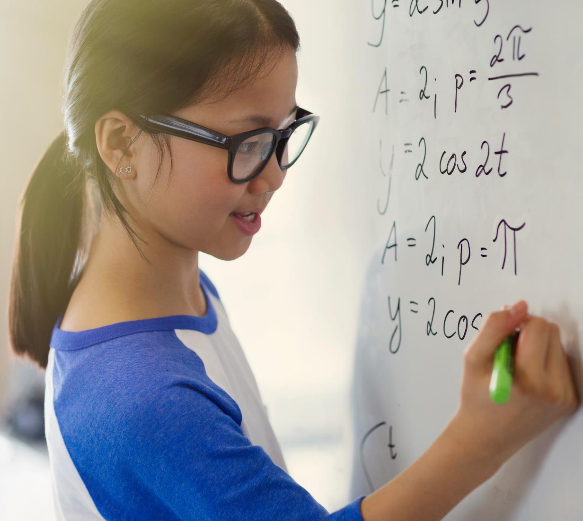
Support Vector Machine (SVM)

Slide 3
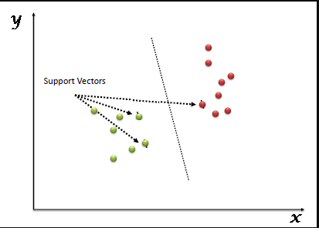
SVM
“Support Vector Machine” (SVM) is a supervised machine learning algorithm that can be used for both classification or regression challenges.
However, it is mostly used in classification problems.

Slide 4
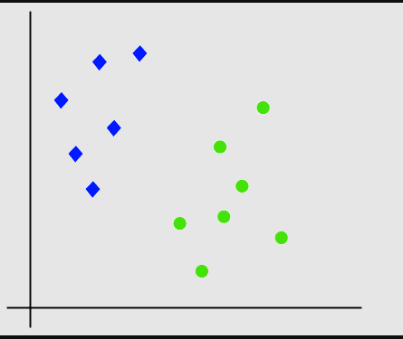
SVM
Let’s imagine we have two tags: green and blue, and our data has two features: x and y.
We want a classifier that, given a pair of (x,y) coordinates, outputs if it’s either green or blue.
We plot our already labeled training data on a plane

Slide 5
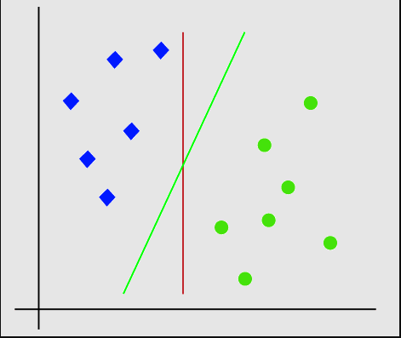
SVM
A support vector machine takes these data points and outputs the hyperplane (which in two dimensions it’s simply a line) that best separates the tags.
This line is the decision boundary: anything that falls to one side of it we will classify as blue, and anything that falls to the other as red.

Slide 6
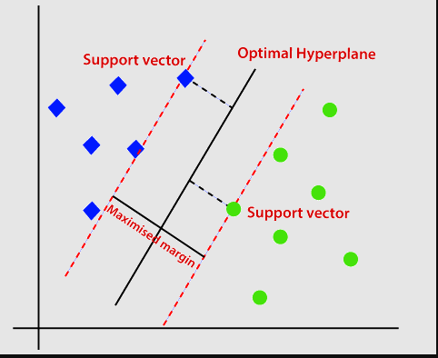
SVM
SVM algorithm helps to find the best line or decision boundary; this best boundary or region is called as a hyperplane. SVM algorithm finds the closest point of the lines from both the classes.
These points are called support vectors.
The distance between the vectors and the hyperplane is called as margin.
And the goal of SVM is to maximize this margin.
The hyperplane with maximum margin is called the optimal hyperplane

Slide 7
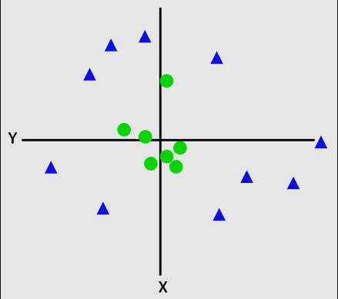
Non-Linear SVM
If data is linearly arranged, then we can separate it by using a straight line, but for non-linear data, we cannot draw a single straight line.

Slide 8
Non-Linear SVM
So, to separate these data points, we need to add one more dimension. For linear data, we have used two dimensions x and y, so for non-linear data, we will add a third-dimension z.
It can be calculated as: z=x2 +y2

Slide 9
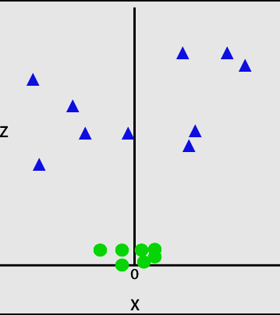
Non-Linear SVM
By adding the third dimension, the sample space will become as below image:

Slide 10
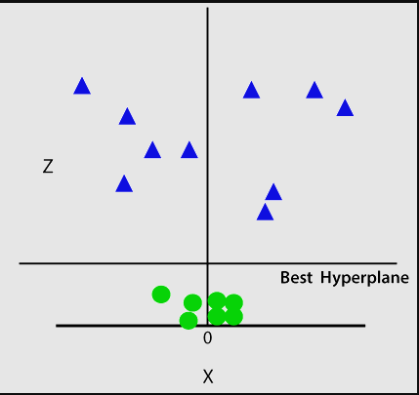
Non-Linear SVM
So now, SVM will divide the datasets into classes in the following way. Consider the below image:

Slide 11
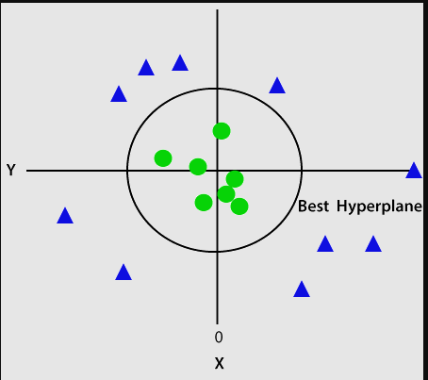
Non-Linear SVM
Since we are in 3-d Space, hence it is looking like a plane parallel to the x-axis. If we convert it in 2d space with z=1, then it will become as:

Slide 12
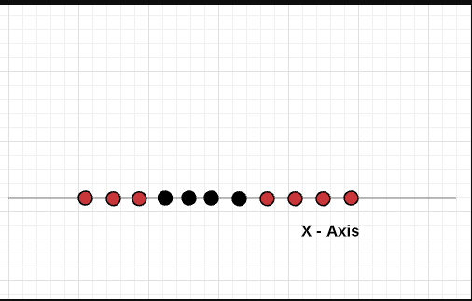
Non-Linear SVM
simple example of data in 1 dimension which is not easy to separate and how adding another dimension makes it easy.

Slide 13
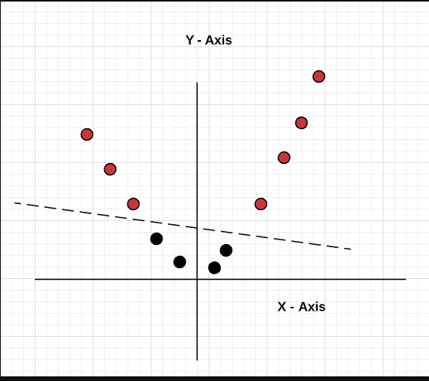
Non-Linear SVM
Let’s apply the method of adding another dimension to the data by using the function Y = X^2 (X-squared).
Thus, the data looks like the following after applying the kernel function (Y = X^2) and becomes linearly separable.

Slide 14
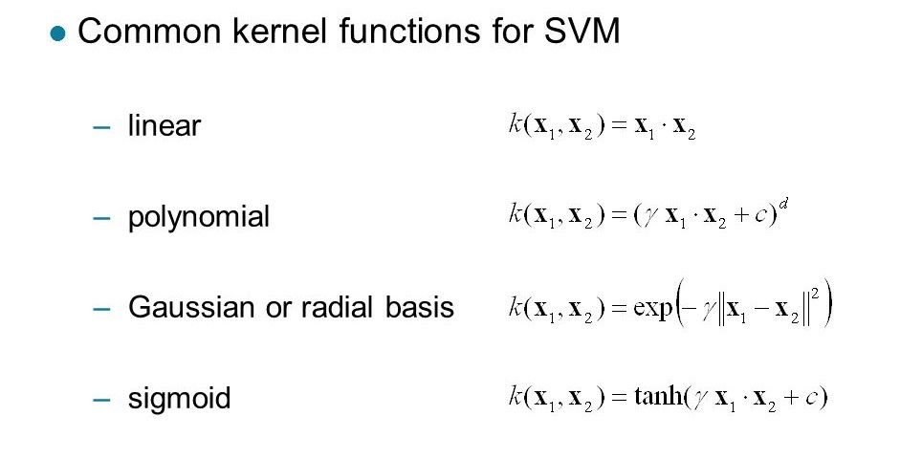
SVM Kernel Trick

Slide 15
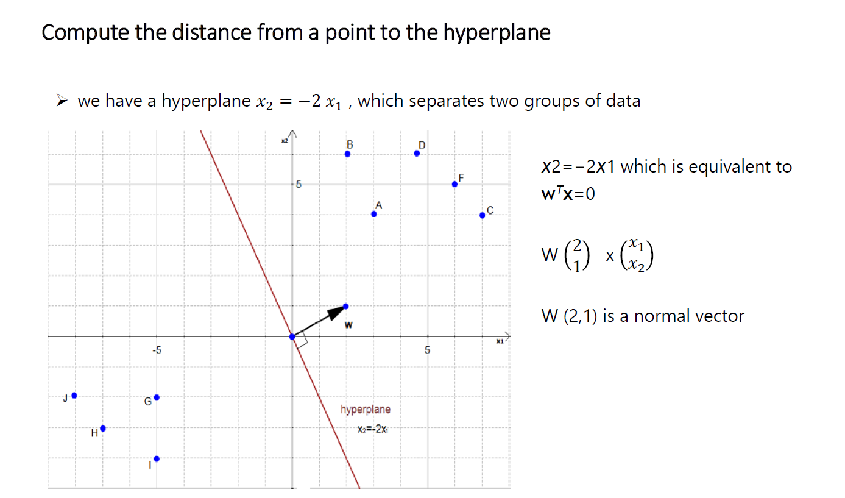

Slide 16
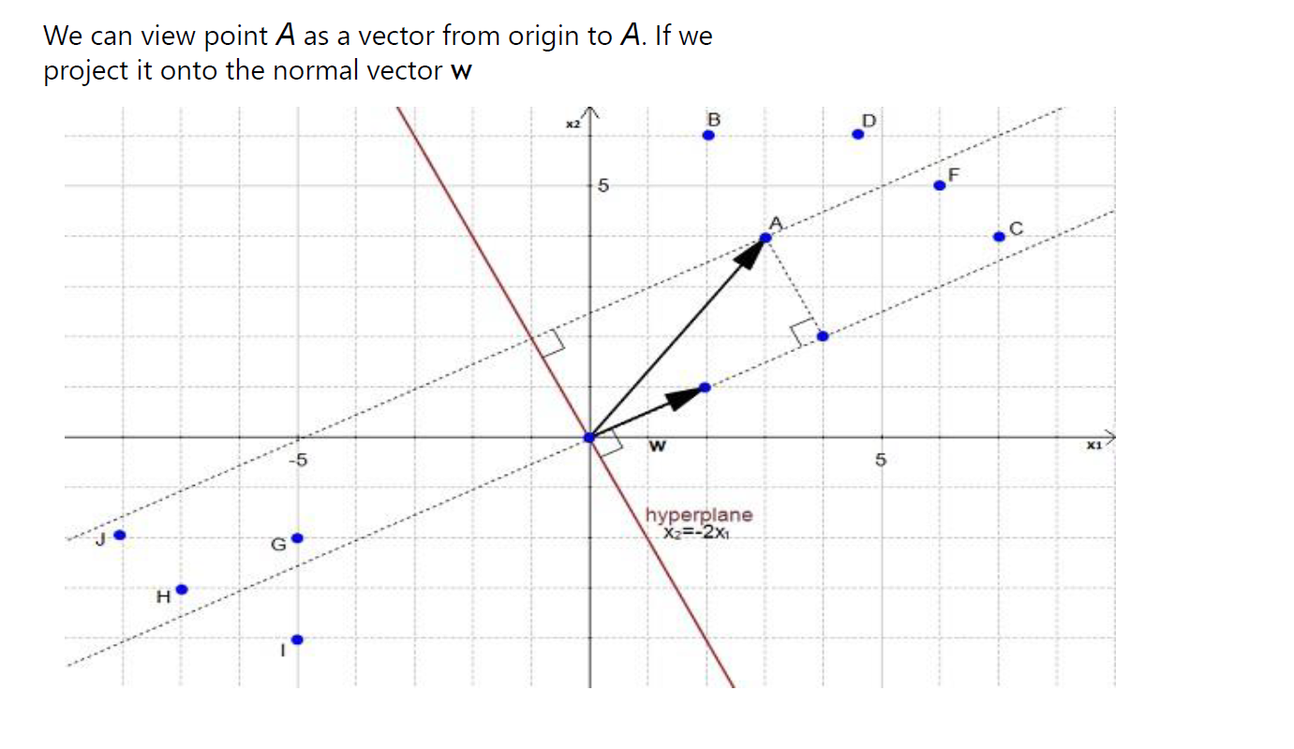

Slide 17
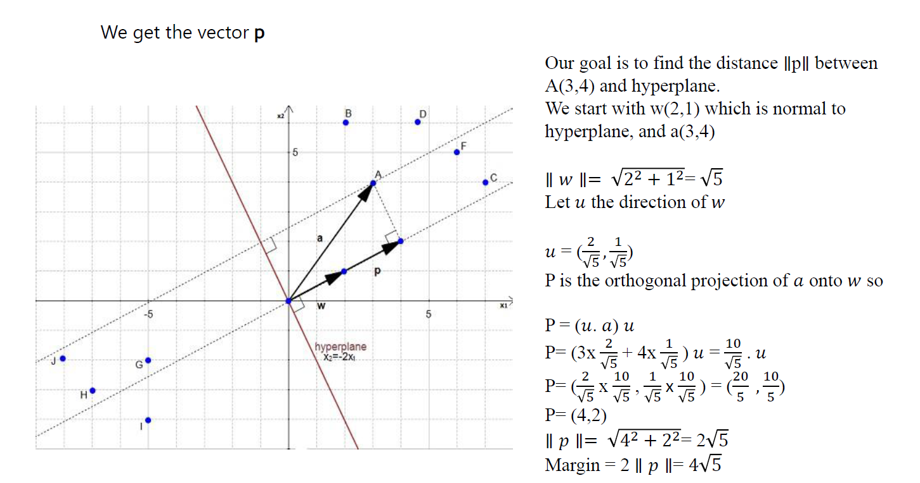

Slide 18


